Slide 1
FARMING ASSISTANT

Slide 2
Introduction
The Farming Assistant is an application to assist the farmers in each and every stage of cultivation from the beginning.
Assistance means suggesting, referring or giving any suggestions they require i.e. Giving information about soil, seeds, fertilizers, weather reports, price analysis etc.
To provide the suggestions made by the researchers and scientists on certain crop issues.
Giving awareness to the farmer about the daily fluctuations of the market prices of the agri-products.

Slide 3
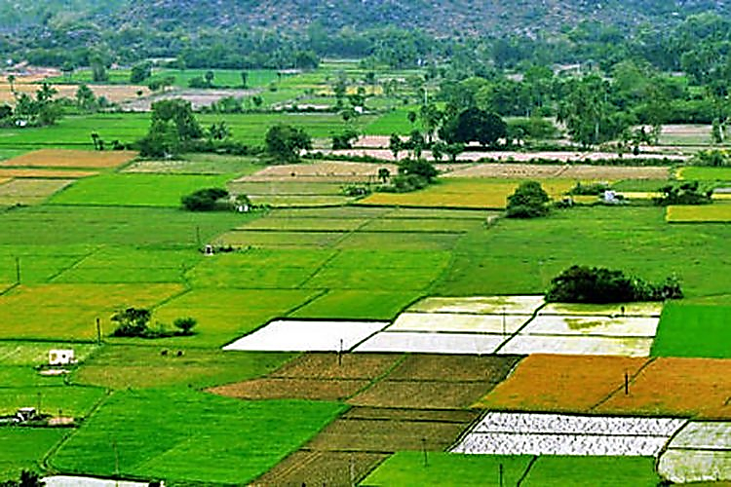
List of Modules
Farmer Module
Assistant Module
Admin Module
1
2
3

Slide 4
Working
Admin
Assistant
Farmer - 1
Farmer - 2
Farmer - 3

Slide 5
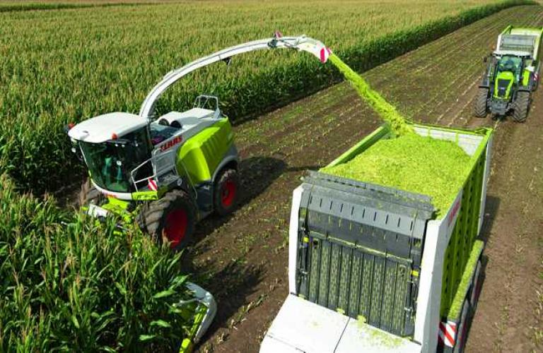
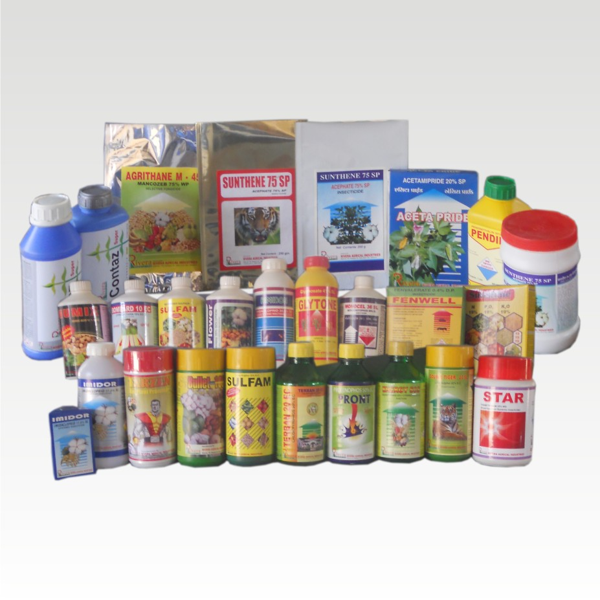
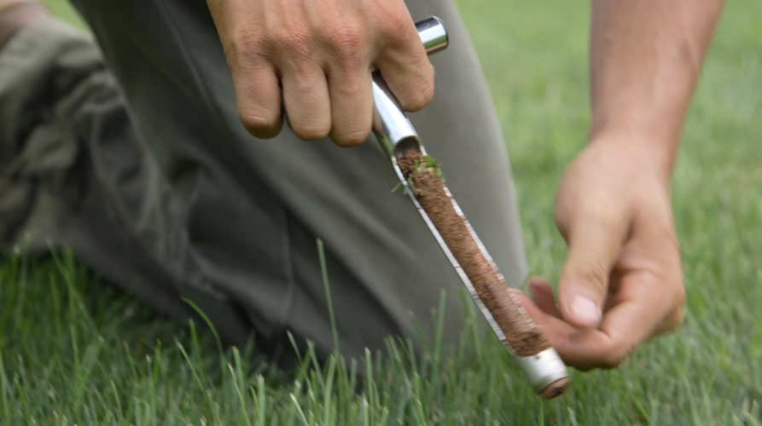
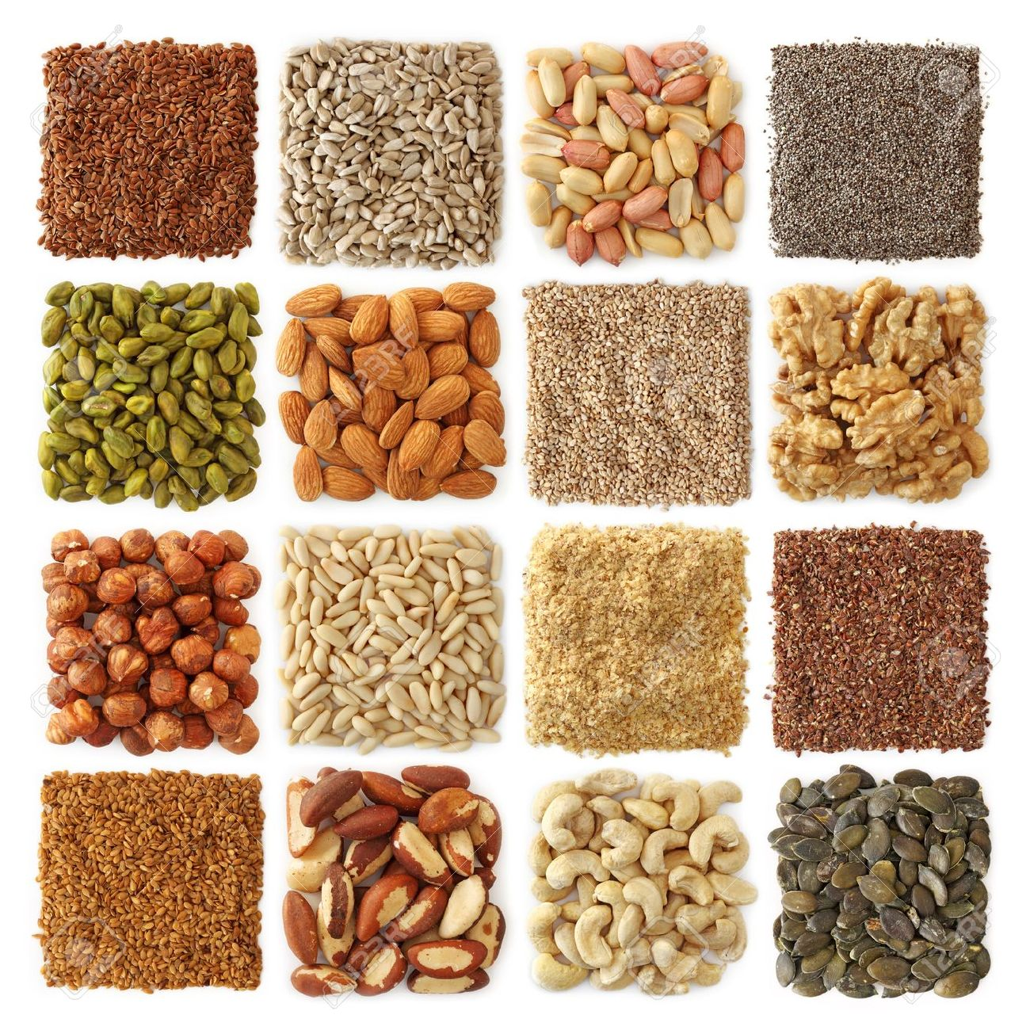
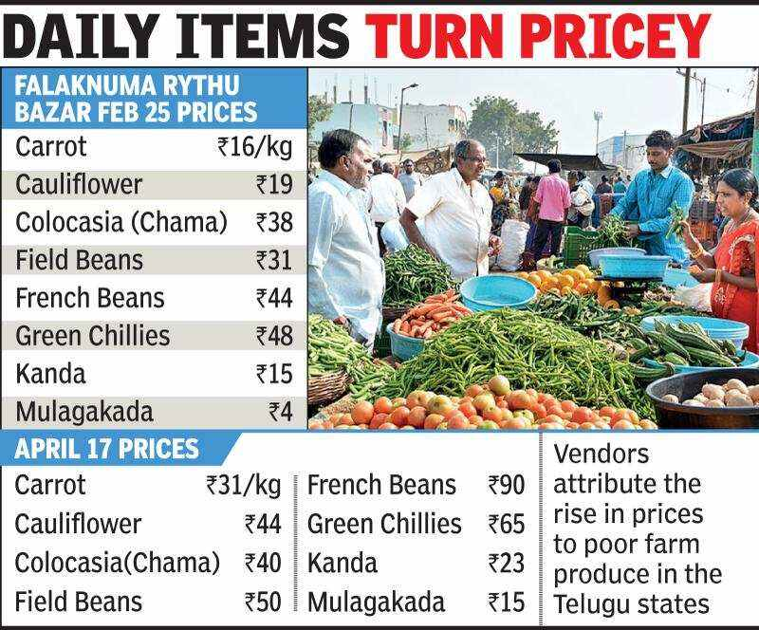
What is the use of this application ?
Soil Testing by the concern Department Officers
Helping to select the best seeds in the market
Helping to select the best pesticides and fertilizers in the market
Weekly Updates about the market prices of the Agri Products
Help to select which type of machinery is useful for crops

Slide 6

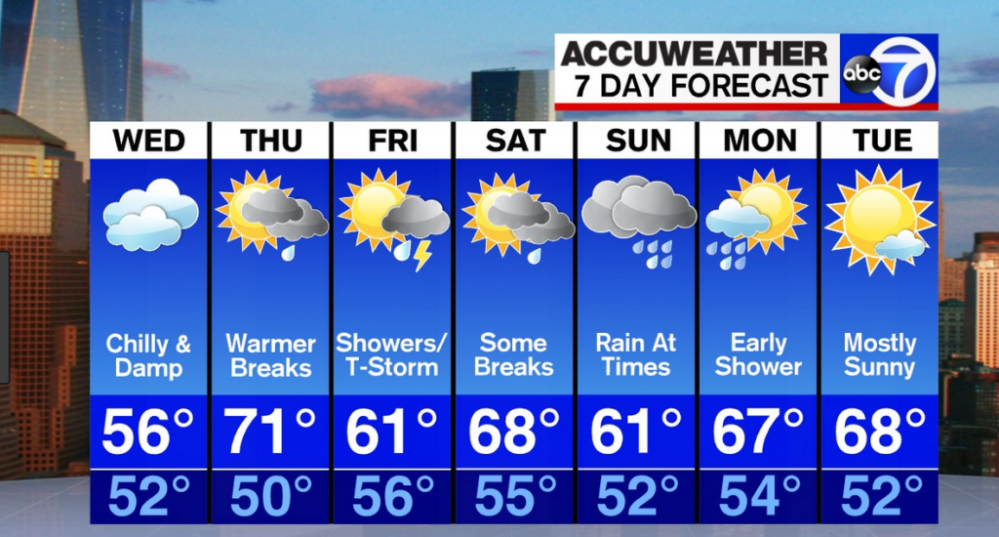
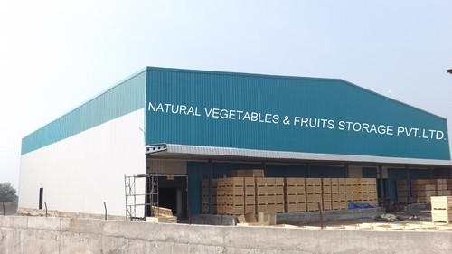

What is the use of this application ?
Weather reports and Time analysis
Giving cold storage details
Crop Protections
Suggestions from the scientists

Slide 7
Features
Crop Protection
Price Analysis
Weather Reports
Fertilizers
Seeds
Soil Analysis
Crop Protection
Price Analysis
Weather Reports

Slide 8
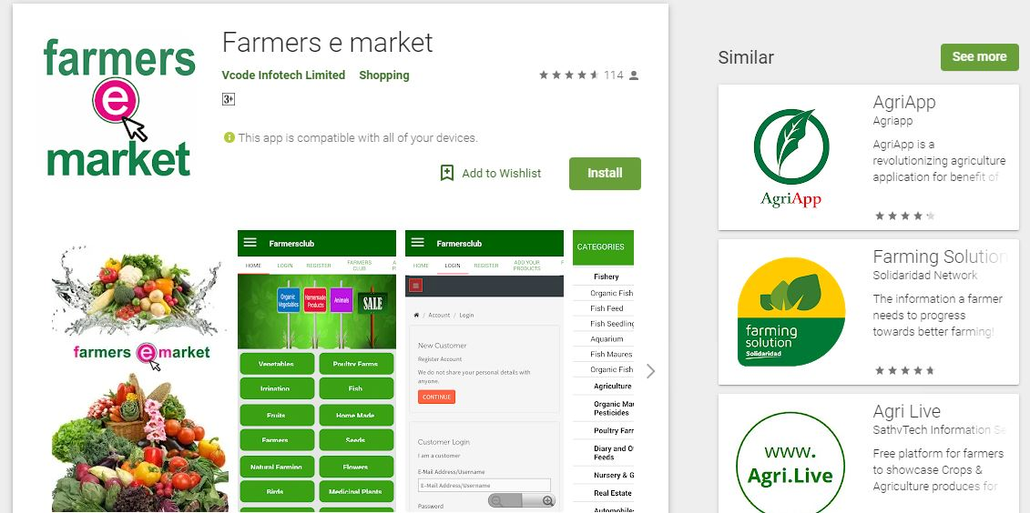
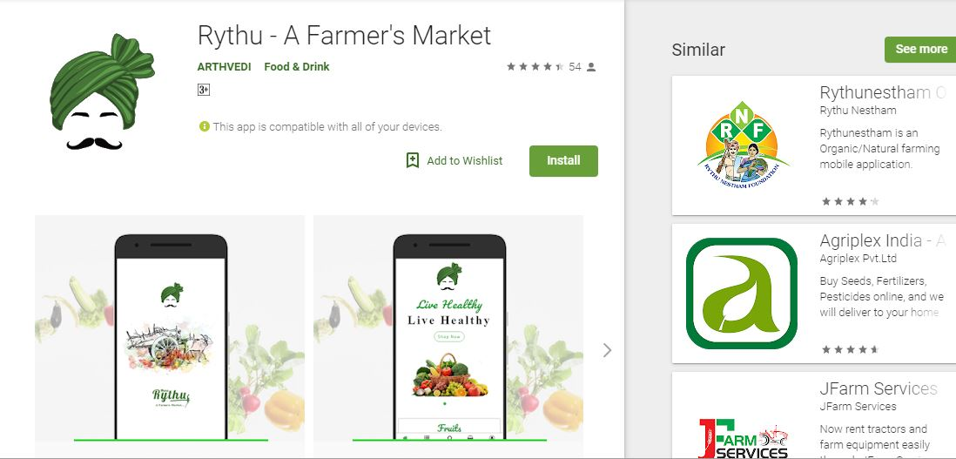
Existing Models

Slide 9
Future Scope
Direct contact to Scientists
D
An Online Rythu Market
Spot Soil Analysis
On Spot crop Sale
Pre Booking for Equipment
Workers gatherings

Slide 10
Conclusion
The main theme of the application is to assist farmers about the crops.
To help farmers to select the seeds, pesticides etc.
To guide the farmers about the latest technologies which are useful for agriculture.
To give awareness about the daily price variations of the Agri-Products.

Slide 11


